Slide 1
Distributed Scheduling

Slide 2
References:
Mukesh Singhal, Niranjan Shivaratri. “Advanced concepts in operating systems”. Tata McGraw Hill publication.

Slide 3

Introduction
Distributed systems offer a tremendous processing capacity.
however, in order to realize this tremendous computing capacity, and take full advantage of it, good resource allocation schemes are needed.
A distributed scheduler is a resource management components of a distributed operating system that focuses on judiciously and transparently redistributing the load of the system among the computers such that overall performance of the system is maximized.

Slide 4
Introduction
Due to random arrival of tasks and their random CPU service time requirements, there is a good possibility that several computers are heavily loaded (hence suffering from performance degradation), while others are idle or lightly loaded.
Ms.Reema Patel, Distributed Computing, M.Tech.-I, SVNIT, 2010

Slide 5
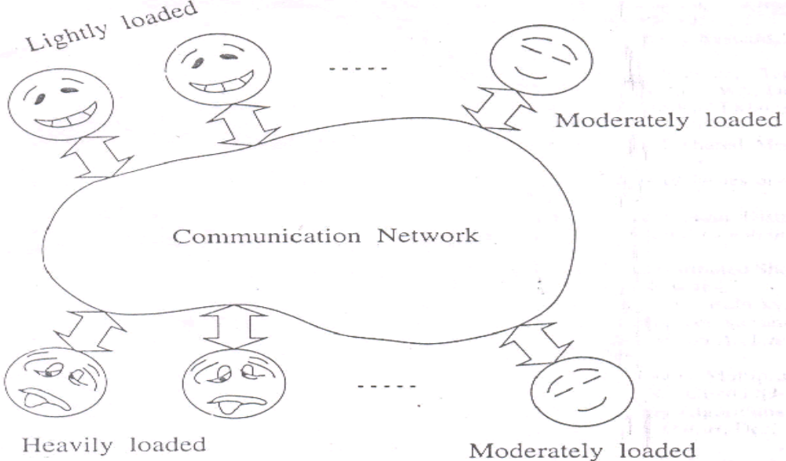
Introduction

Slide 6
Introduction
Goal: To improve the performance of distributed system by appropriately transferring work from heavily loaded computer to idle or lightly loaded computer.
  Performance of a system
    One of the metric is average response time of task which is the length of the time interval between its origination and completion.
    Minimizing the average response time is often the goal of load distributing.
  Defining a proper characterization of a load at node is very important, as load distributing decisions are based on the load measured at one or more nodes.
  The mechanism used to measure load imposes minimal overhead.

Slide 7
Issues in Load Distributing
Several central issues in load distributing
Load:
CPU queue length are good indicators of load .
As a result , when all the tasks that the node has accepted have arrived , the node can become overloaded and require further task transfers to reduce its load.
  Prevention- Artificially increment CPU queue length at a node whenever the node accepts a remote task.
  Use timeout to avoid anomalies when task transfers fail.
  After the timeout, if the task has not yet arrived, the CPU queue length is decremented.

Slide 8
Issues in Load Distributing
Classification of load distributing algorithms:
Broadly characterized as:
  Static
    Decision is hard wired in the algorithm, using a priory knowledge of the system.
    They make no use of system state information (the loads at nodes).

Slide 9
Classification of load distributing algorithms
  Dynamic
    Make use of system state information to make load distributing decisions
    They collect, store and analyze the system state information.
    Impose overhead to the system
  Adaptive
    Special class of dynamic algorithm
    they adapt their activities by dynamically changing the parameters of the algorithm to suit the changing system state

Slide 10
Issues in Load Distributing
Load distributed algorithms can further be classified as Load balancing vs. Load sharing algorithms
Both types of algorithms attempt to reduce the likelihood of an unshared state by transferring tasks to lightly loaded nodes.
Unshared state : A state in which one computer lies idle while at the same time tasks argue for service at another computer
Load balancing algo:
  Attempt to equalize the loads at all computers

Slide 11
Load balancing vs. Load sharing
Task transfer are not instantaneous because of communication delays.
Delays in transferring a task increase the duration of unshared state.
To avoid lengthy unshared states, blocking task transfers from overloaded computers to computers that are likely to become idle shortly can be used.

Slide 12
Issues in Load Distributing
Preemptive vs. Non-preemptive transfers:
Preemptive:
  Transfer of a task that is partially executed
Non preemptive:
  Transfer of a task that has not yet started execution
Information about the environment in which the task will execute must be transferred to the receiving node. Ex: user’s current working directory, privileges inherited by the task

Slide 13
Requirements for Load Distributing
Scalability: It should work in large distributed system
Location transparency: It should hide the location of processes.
Determinism: A transferred process must produce the same results it would produce if it was not transferred.
Preemption: Remotely executed processes should be preempted and migrated elsewhere on demand.
Heterogeneity: It should be able to distinguish among different processors.

Slide 14
Components of Load Distributing algorithm
Four components
  Transfer policy
    Determines whether a node is in a suitable state to participate in a task transfer
  Selection policy
    determines which task should be transferred
  Location policy
    determines to which node a task selected for transfer should be sent
  Information policy
    responsible for motivating the collection of system state information

Slide 15
Transfer policy
A large number of the transfer policies are threshold policies.
  Better to decide the sender and receiver.
  when a new task originates at a node, and the load at the node exceeds a threshold T, the transfer policy decides that the node is sender.
  If the load at a node falls below, the transfer policy decides that the node can be a receiver for a remote task.

Slide 16
Selection Policy
Selects a task for transfer, once the transfer policy decides that the node is a sender
Simplest approach: to select the newly originated task
Overhead incurred in task transfer should be compensated by the reduction in the response time realized by the task
Bryant and Finkel propose another approach - a task is selected for transfer only if its response time will be improved upon transfer.
Factors to consider:
  Overhead incurred by transfer should be minimal. For example, a task of small size carries less overhead.
  Number of location dependent system calls made by the selected task should be minimal

Slide 17
Location Policy
To find suitable nodes to share load (sender or receiver)
Widely used method : polling- a node polls another node to find out whether it is suitable node for load sharing
  Either serially or in parallel (e.g., multicast)
  Either randomly or on a nearest-neighbor basis
Alternative to polling
  Broadcast a query to find out if any node is available for load sharing

Slide 18
Information Policy
To decide when, where and what information about the states of other nodes on the system should be collected
One of three types:
  Demand driven
    Node collects the state of the other nodes only when it becomes either a sender or a receiver
    dynamic policy
    can be sender-initiated or receiver-initiated

Slide 19
Information Policy
  Periodic
    Nodes exchange load information periodically
  State change driven
    Nodes distribute state information whenever their state changes by a certain degree
    Centralized policy- nodes send the state information to a centralized collection points and decentralized policy- nodes send the information to peers.

Slide 20
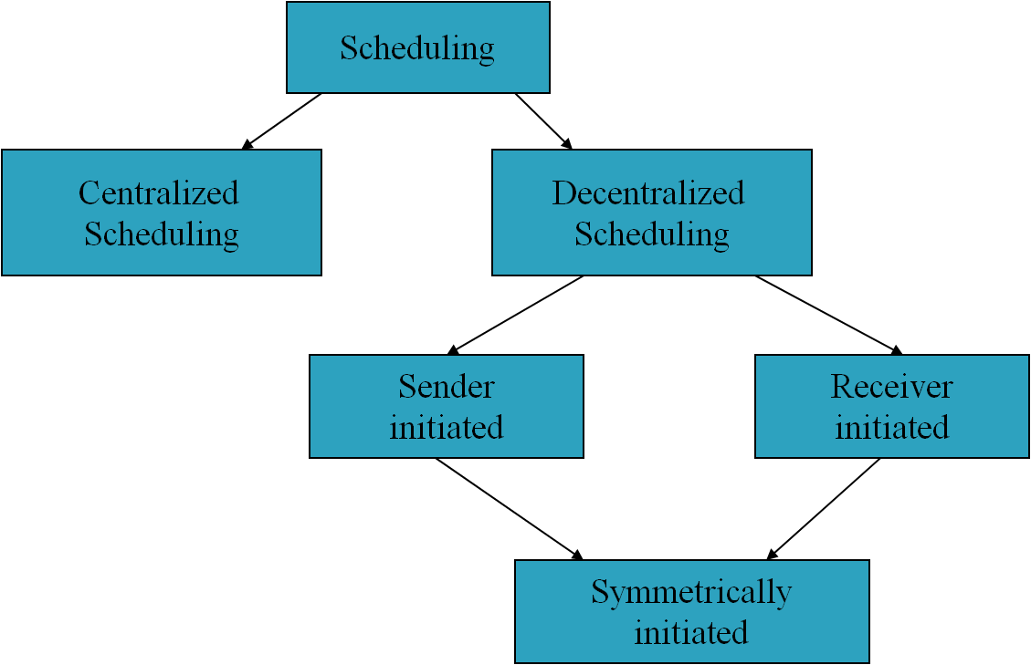
Types of Scheduler

Slide 21
Sender-Initiated algorithms
Load distributing activity is initiated by an overloaded node (sender) that attempts to send a task to an underloaded node (receiver).
Transfer Policy: A Threshold policy based on CPU queue length used by the algorithms
  A node is identified as a sender if a new task originating at the node makes the queue length exceed a threshold T.
Selection Policy: These sender-initiated algorithms consider only newly arrived task will be transferred.

Slide 22
Sender-Initiated algorithms
Location policy:
  Random :
    Node is randomly selected & task is simply transferred.
    No information exchange to assist in decision making
    Problem – useless task transfers may occur when a task is transferred to a node that is already heavily loaded.
    Solution – limit the number of times a task can be transferred
    It provides significant performance improvement over no load sharing

Slide 23
Sender-Initiated algorithms
Location policy:
  Threshold :
    The problem of useless task transfer can be avoided using polling (selected a random)
    Node is polled to determine whether it is a receiver
    The number of polls is limited by a parameter called PollLimit to keep the overhead low
    A sender node will not poll any node more than once during one searching session of PollLimit polls
    If no suitable node is found, then the sender node must execute the task
    It provides significant performance improvement over the random location policy
    Flowchart

Slide 24
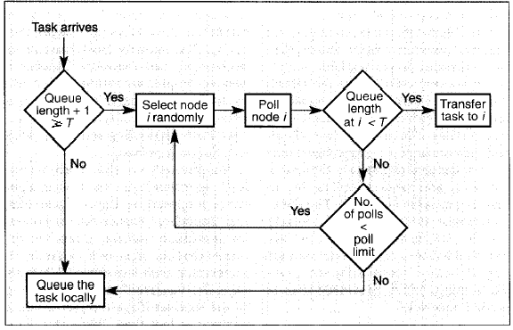
Sender-Initiated algorithms

Slide 25
Sender-Initiated algorithms
Location policy:
  Shortest :
    It makes effort to choose the best receiver for a task
    Number of nodes (=PollLimit) are selected at random and are polled to determine their queue length
    Node with shortest queue length is selected
    The destination node will execute the task regardless of its queue length at the time of arrival of the transferred task.
    Performance improvement is marginal indicating that more detailed state information does not necessarily result in significant improvement in system performance

Slide 26
Sender-Initiated algorithms
Information Policy
  Demand driven
Stability
  All three approaches for location policy cause system instability at high system loads.
  In highly loaded system, probability of finding receiver is very low,
  When the load due to work arriving and due to the load sharing activity exceeds the system’s serving capacity, instability occurs.

Slide 27
Receiver-Initiated Algorithms
Load distributing activity is initiated from an under-loaded node (receiver) that is trying to obtain a task from an overloaded node (sender).
Transfer Policy:
  Threshold policy based on CPU queue length
  Transfer policy is triggered when a task departs
Selection Policy:
  Any of the approaches as discussed earlier.

Slide 28
Receiver-Initiated Algorithms
Location Policy:
  Randomly selected node is polled
  Above procedure is repeated until a node that can transfer a task (i.e.,a sender) is found or a static PollLimit number of tries have failed to find a sender
  If all polls fail to find a sender, the node waits until another task completes or until a predetermined period is over before initiating the search for a sender

Slide 29
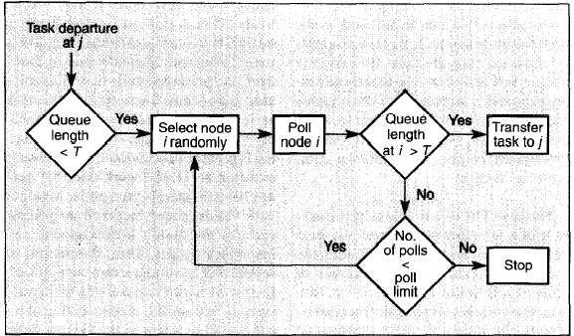
Receiver-Initiated Algorithms

Slide 30
Receiver-Initiated Algorithms
Information Policy:
  Demand driven because the polling activity starts only after a node becomes a receiver
Stability:
  They do not cause system instability
  Very little wastage of CPU cycles at high system loads
  At low system loads, more receiver initiated polls do not cause system instability as spare CPU cycles are available
Drawback:
  Most transfers are preemptive and therefore expensive

Slide 31
Symmetrically Initiated Algorithms
In symmetrically initiated algorithm, both senders and receivers search for receivers and senders, respectively, for task transfers.
These algorithms have the advantages of both sender and receiver initiated algorithms.
At low system loads, the sender-initiated component is more successful in finding under-loaded nodes. At high system loads, the receiver-initiated component is more successful in finding overloaded nodes.
As in sender-initiated algorithms, cause system instability at high system loads.
Receiver-initiated algorithms, a preemptive task transfer is necessary.

Slide 32
Symmetrically Initiated Algorithms
Transfer Policy:
  Threshold policy which uses two adaptive thresholds
  Thresholds (two) are equidistant from the node’s estimate of the average load across all nodes
  Example
  Node’s estimate of the average load = 2
  Lower threshold = 1
  Upper threshold =3
A node whose load is greater than upper threshold → a sender
A node whose load is less than lower threshold → a receiver.
Nodes that have loads between these thresholds lie within the acceptable range, so they are neither senders nor receivers.

Slide 33
Symmetrically Initiated Algorithms
Location Policy: It has two components
  Sender-Initiated Components
  Receiver Initiated Components
Sender-initiated component:
  Sender:
    Broadcast TooHigh message
    Set TooHigh timeout alarm
    Listen for an Accept message until timeout expires
  Receiver:
    Receive TooHigh message
    Send Accept message to sender
    Sets AwaitingTask timeout alarm
    Increases its load value before accepting a task. Why????
    If Awaiting Task timeout expires without the arrival of transferred task , the load value at the receiver is decreased.

Slide 34
Symmetrically Initiated Algorithms
On receiving an Accept message, if the node is still a sender, it chooses the best process to transfer and transfer it to the node that responded.
On expiration of TooHigh timeout, if no Accept message is received,
  Sender guesses that its estimate of the average system load is too low ( since no node has a load much lower)
  Hence, it broadcasts a ChangeAverage message to increase the average load estimate at the other nodes.

Slide 35
Symmetrically Initiated Algorithms
Receiver-initiated component
  broadcasts a TooLow message
  Sets a TooLow timeout alarm
  listening for a TooHigh message
  If a TooHigh message is received, the receiver performs the same actions that it does under sender-initiated negotiation
  If the TooLow timeout expires before receiving any TooHigh message, the receiver broadcasts a ChangeAverage message to decrease the average load estimate at the other nodes

Slide 36
Symmetrically Initiated Algorithms
Selection policy: This algorithm can make use of any of the approaches discussed earlier.
Information policy: The information policy is demand-driven.
Key Points:
  The average system load is determined individually at each node, imposing little overhead.
  Acceptable range determines the responsiveness of the algorithm.

